Slide 1
Comparative study on uMap and t-SNE
Author: Deniz Geçer
Supervisor: Stéphane Marchand-Maillet
Master's thesis

Slide 2
Plan
Problems
Questions
State of the art
Proposed solution
Experiments
Results
Conclusion

Slide 3
Problems
Huge quantity of data
Overfitting
Equidistance of points
Sparsity
High correlation
Curse of dimensionality

Slide 4
Questions
How is the reliability of the reduced data with respect to the original one measured?
On which criteria the comparison between multiple reduction techniques is made
What is the relation between the strength of the reduction and the loss of information?
How is the stability of reduction techniques analyzed?
Notes:
How do we analyse the stability -> + necaissaire de comprendre impact des parametres sur resultat et stabilité (experiment2) -> loss, shepard plot
Experiment 3 -> impact relation strength and loss of info

Slide 5


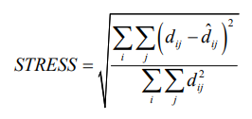
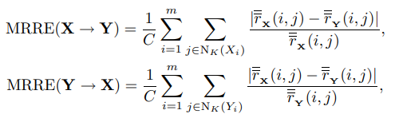
State of the art
Evaluation metrics and methodology
(Stephen France, 2007)
Stress as a metric (MDS)
global distance conservation
(Rasa Karabauskaite, 2008)
Topology preservation measures
Spearman’s rho
Konig’s Measure
Mean Relative Rank Errors (MRRE)
Notes:
Rasa compare metric laquelle estime mieu ? -> les troix bonnes- global-local METHODE BASe SUR LE RANG ET PAS DISTANCE
Analyse evolution metric selon variation parametre de la DR
Analyse Konig en faisant varié les k
Analyse MRRE en faisant varié K
Use swiss roll

Slide 6

State of the art
Evaluation metrics and methodology
(Francisco J. García-Fernández, 2013)
Stability comparaison methodology
Impact of parameters on embedding
Impact of data on embedding (Increase number of points)
Fixing the initialization technique and minimizing randomness
(Antonio Gracia, 2014)
Methodology to compare the reduction in terms of loss of quality
Use and comparison of all previous metrics
Notes:
Impact initialization sur resultat

Slide 7
State of the art
Evaluation metrics and methodology
(Olga Kurasova, 2018)
Comparison of reduction technique
Clustered data
Non clustered data
Real-world data
(Ruizhi Xiang, 2021)
Aggregation of all metrics to evaluate overall stability
Sensitivity of methods to Hyperparameters
Notes:
Olga mesure = global = stress + spearman (mesure speed nous interesse pas)
Antonio: quality = 1 si bonne préservation selon metric utilisé -> quality loss = 0

Slide 8
Proposed solution
Datasets:
Swiss roll
Clustered data
Non clustered data
Evaluation metrics:
Shepard diagram
Configuration score
Stress
Spearman’s rho
Konig’s measure
Mean relative rank error
Loss
Notes:
Swiss roll: 2 dimensional plot obtained from a gaussian distribution to a 3 dimensional
NC: [-5,5 -> UNIFORM
C: [-10,10]

Slide 9
Experiments
Experiment 1
Add white noise as a 4th dimension with different std to the Swiss Roll dataset
Perform reduction to 3D and 2D using 4 different initialization methods, 4 different std and 4 different perplexity/k
Observe loss function, shepard diagram and plot

Slide 10
Experiments
Experiment 2
Run of 16 different configurations on each dataset with each technique
4 different initialization methods and 4 different perplexity/k value
Compare the 16 configurations using a defined configuration score

Slide 11
Experiments
Experiment 3
Choose a specific configuration
Perform 2D reduction on Swiss-Roll dataset with different perplexity/k value
Perform 2D reduction on clustered and non-clustered data with different features size
Evaluate the impact of perplexity/k and dimensionality using
Stress
Spearman’s rho
Konig’s measure
Mean relative rank error

Slide 12
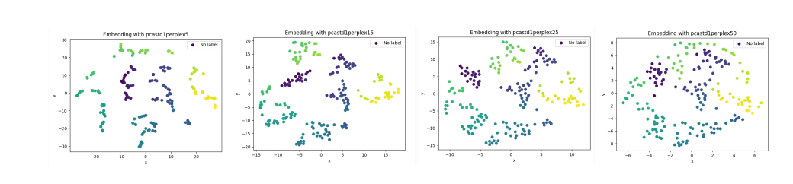
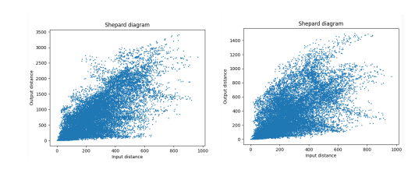
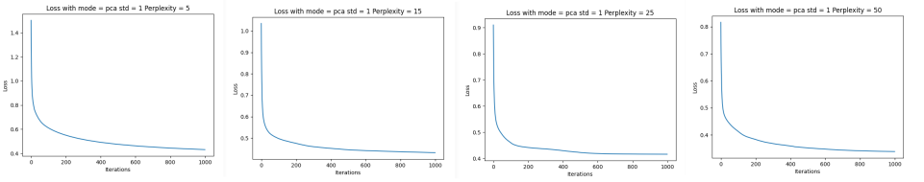
Experiment 1 Results

Slide 13
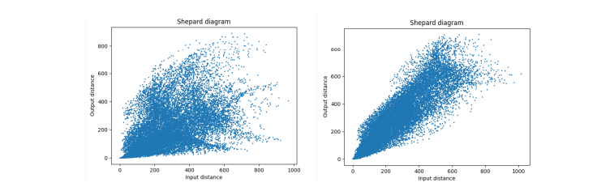
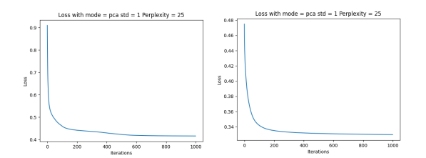
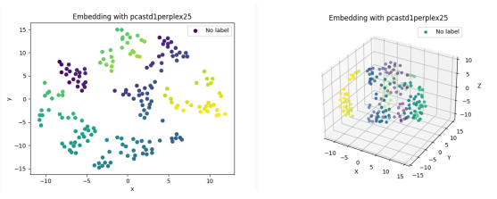
Experiment 1 Results

Slide 14
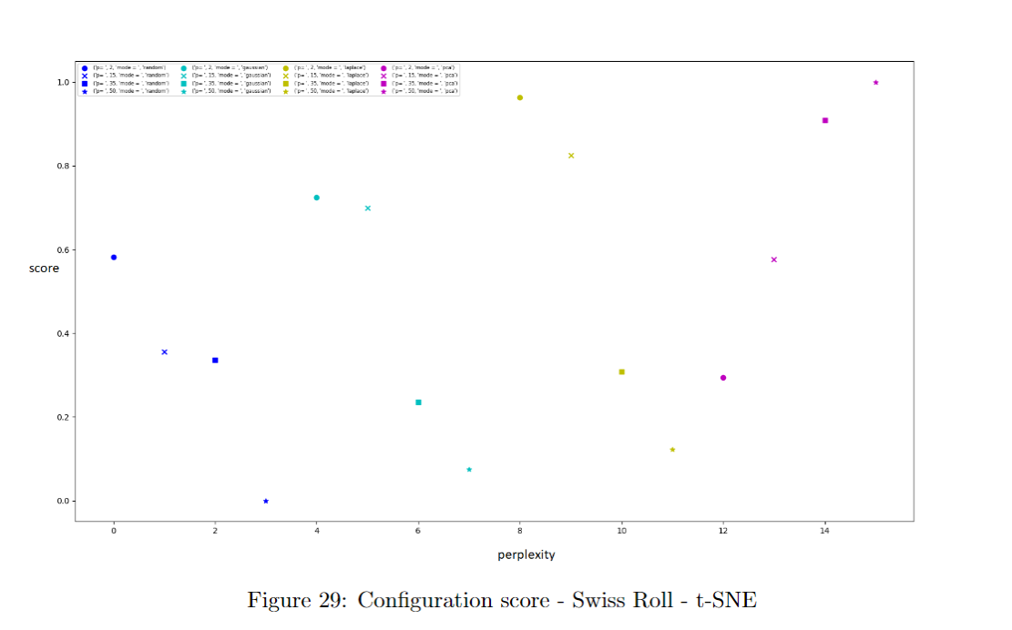
Experiment 2 Results

Slide 15
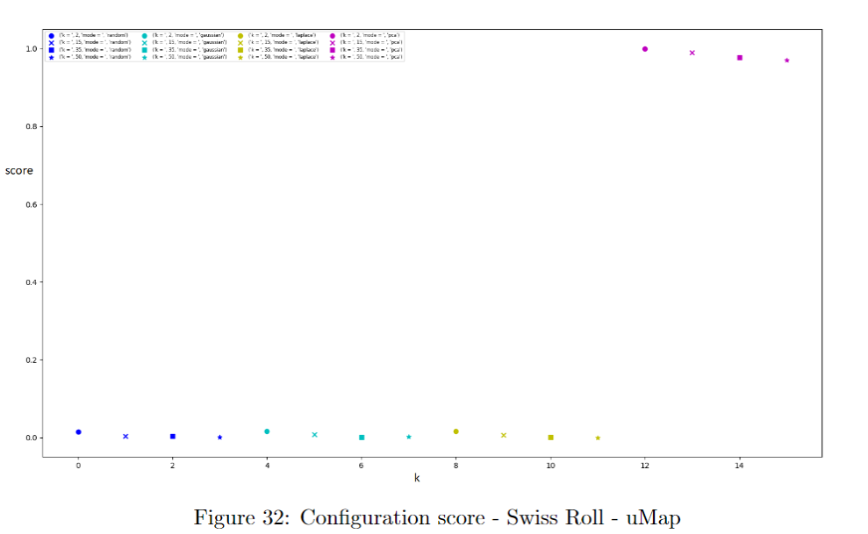
Experiment 2 Results

Slide 16
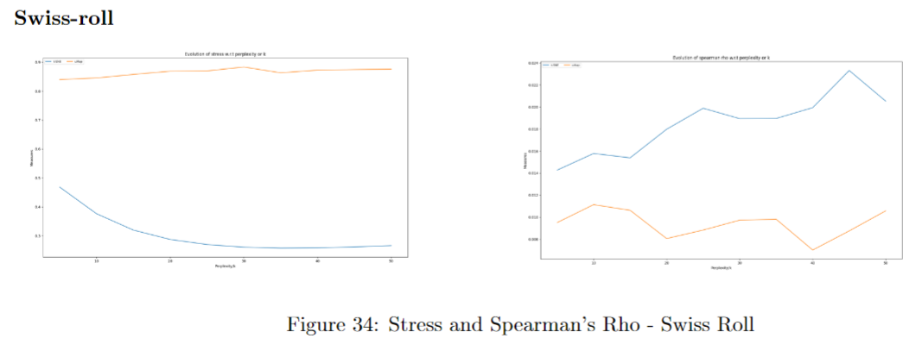
Experiment 3 Results

Slide 17
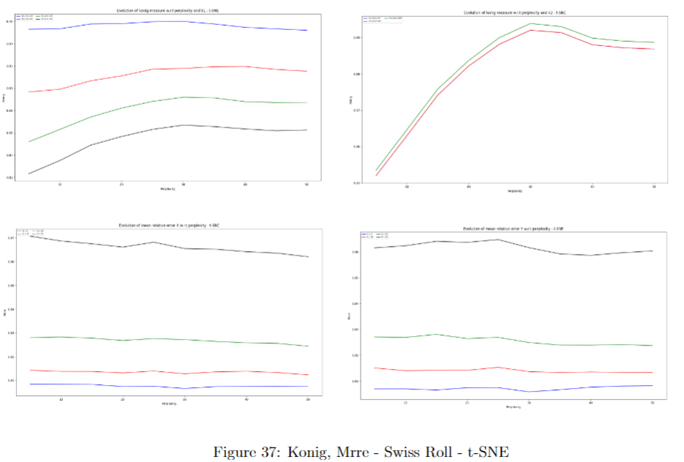
Experiment 3 Results

Slide 18
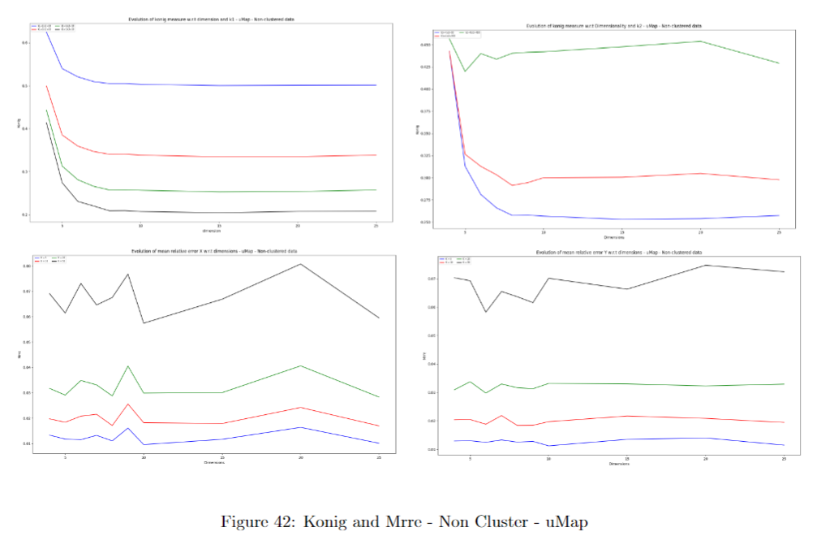
Experiment 3 Results

Slide 19
Conclusion
uMap global preservation
t-SNE local preservation
Light impact of hyperparameters perplexity/k on local and global metrics
Robustness to noise and initialization methods
Main loss on first dimensions
Good rank preservation in the close neighborhoods from both methods
Normalize distances
Deepen research on uMap: min_dist parameter and different distance metric

Slide 20
Thank you for your attention
Deniz Geçer

